Slide 1
Project 1
Mauricio Carrillo
Carlos Alvarez
Victor Cardona
Adrian Flores
Erick Hernandez
Victor Alvarado
Analyzing a loyalty program in the automotive industry
Team 8
Notes:
Mau

Slide 2
Background Story
Loyalty Program Overview
The company’s loyalty program has been around for 14 years. It works with 6 categories to group clients by their sales level.
The sales within the loyalty program have decrease in the last two years (-6.5% in 2019, -7% in 2020)
The program reaches 27 states in Mexico and +120 locations, working with roughly 450 clients overall.
The company works with 16 distributors to reach all their clients.
We focused on the data of a loyalty program for 3 brands of car’s shock absorbers from a company that manufactures them.
Overall sales have been dropping through the last years, but last year COVID-19 pandemic had a tremendous impact over the sales and behaviour in the Loyalty Program. Time to restructure it..
The main OBJECTIVE of our work is to analyze this information to identify key indicators so that we can propose possible improvements.
Notes:
Mauricio

Slide 3
Questions
Data selection
Sales over 36 months
Maturity of sales per customer
Percentage change of Total Sales and Clients Volume
Category compliance through annual sales
Sales by location (state)
Cost of reward points by category
Compliance vs cost of reward points
After COVID-19, Is there anything in the methodology of the program that could be modified in order to optimize the number of points given to the customer or increase the level of revenue to deliver points?
Is there any state or region in Mexico in which we could grow faster and to the lowest cost?
Is there a better way to distribute categories to optimize the Loyalty Program?
Is there a new opportunity for the company to increase sales through its loyalty program after the consequences of COVID-19?
Notes:
Adrian

Slide 4
General Findings
The structure of the category levels is not efficient, a new optimization among them should deliver bigger sales and reduce operational costs.
Main efforts among all regions in Mexico are not well distributed, a new distribution and expansion would impact directly in bigger sales and reduce operation costs.
FINDINGS:
1- Identified the lowest category (C1) was driving the higher cost and it represented the lowest income percent through all, therefore the elimination/merge of this category is proposed.
2- Recovering from COVID-19 showed it was made from only one high purchase.
3- Central region has the best performance and highest sales
Notes:
Victor A

Slide 5

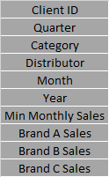
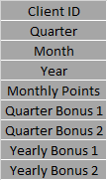
Data cleanup and exploration
Data cleaning in general was easy. Since all data came from a unique source, it was well organized. Overall, we worked with 3 different data sets. They described client’s location, client’s sales over the last 36 months, and client’s points generation
Notes:
Victor C

Slide 6
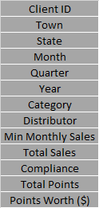
Data cleanup and exploration
Working with those 3 data sets, we took the info we found interesting and add
some totals.
We also find out that the company gives a $0.86 value to each point that a client
generates. With that specific information, we could calculate points worth over
months.
Notes:
Victor C

Slide 7
Data and Plots analysis
OPPORTUNITY
USEFULL
PURPOSE

Slide 8
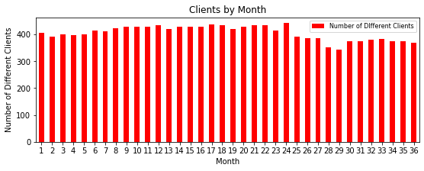
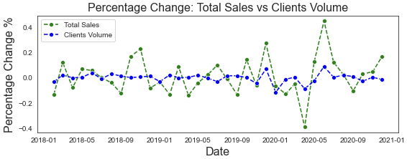
CLIENTS
Fig 1 ( ) Clients by month
Fig 2 ( ) Total sales vs volume of clients
A significant drop in clients during the pandemic is observed in the chart.
2020 April: - %8.8
2020 May: - %2.5
Despite the drop in clients during pandemic, total sales were impacted just for a short time with a significant increase and stabilization after 2020 - May.
The main contributor that help maintaining the total sales stable was the addition of new customer with high purchase capacity.
Notes:
Adrian

Slide 9
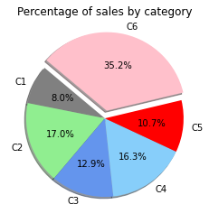
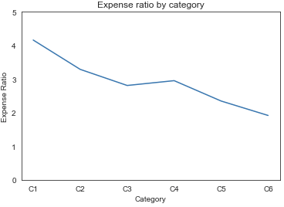
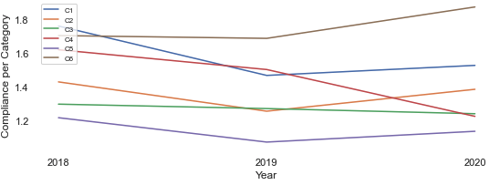
CATEGORIES
Fig 3 ( ) - Sales and cost of loyalty program by category
Fig 4 ( ) - Compliance by category
Main sales were driven by C6 whilst the cost of the program was the lower amongst categories.
C1 is the most expensive category for the company (highest expense ratio) and provides the lowest sales.
C6 has the best track of compliance by category over the 3 years analyzed.
C4 is the only one that had a significant drop of compliance during 2020.
Notes:
Victor A

Slide 10
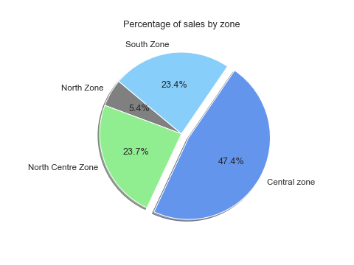
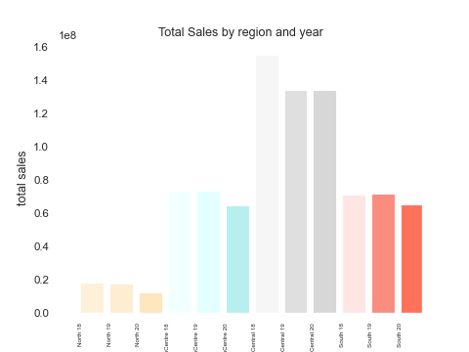
REGIONS
Fig 5 ( ) Analyzing sales by region
-The central zone was the main contributor to the total sales of the company and also it was the region that was less impacted in terms of sales during 2020
-The central zone was the only region that did not decrease sales in 2020
- Small presence in north zone (4.5% total sales) and biggest drop in 2020 (-30%)
- Central North and south zone decrease similar in relation to the countries economy (-12%, -9%)
Notes:
Carlos

Slide 11
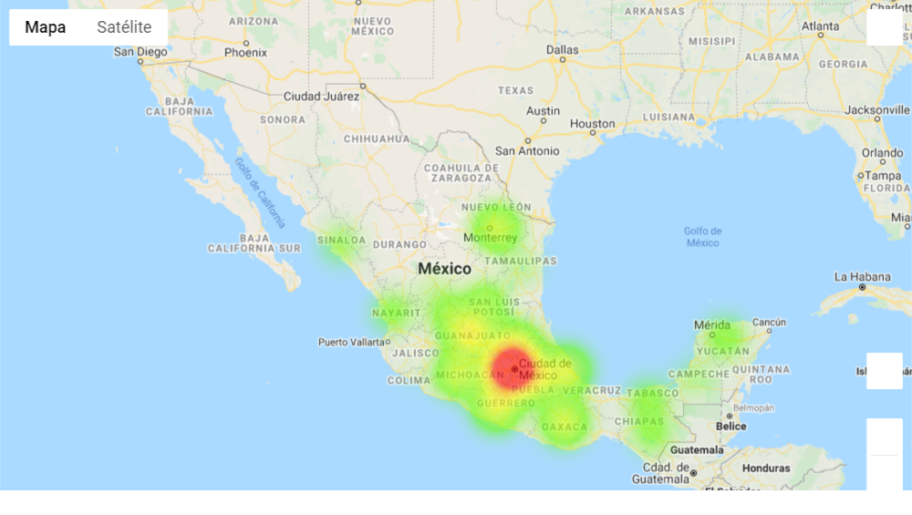
REGIONS
-To reinforce last slide plots, we can observe in this map the sales distribution in the analyzed months.
Fig 6 ( ) Region Sales Heatmap
Notes:
Carlos

Slide 12
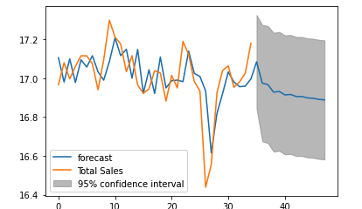
PREDICTION (ARIMA MODEL)
ARIMA: autoregressive integrated moving average
Fig 7 ( ) Prediction model (ARIMA)
According to prediction model, it is forecasted a sustained drop in sells in the coming months.
One point to consider is that the forecasted sales predicted by the model are probably penalized by the drop in sales during pandemic. This affected the calculations of rolling mean to adapt the data set’s stationality.
Notes:
Victor A

Slide 13
Discussion
After analyzing...
Total sales and customer volume by month over the three year period, and how this two elements were impacted during pandemic.
We know that ….
Categories distribution to determine the cost of the reward program, the sales and the compliance.
We know that ….
Performance per region to determine if there is any of them that has been growing fast and orient efforts to expand market share.
Notes:
Victor C

Slide 14
Conclusions / Next Steps
The structure of the category levels is not efficient, a new optimization among them should deliver bigger sales and reduce operations costs.
Main efforts among all regions in Mexico are not well distributed, a new distribution and expansion would impact directly in bigger sales and reduce operational costs.
Moving forward into our first conclusion, we propose:
Reduce number of categories:
Merge in two or three categories
Overall, propose a new mechanic where less bonus points are granted, and points are more related to sales volume.
Moving forward into our second conclusion, we propose:
If we had the total company sales (with non-loyalty program members included), we would be able to provide a better analysis for potential opportunities to expand business in certain regions.
Notes:
Mauricio

Slide 15
Q&A

